Slide 1
Registration System
Abdulrahman essa Alkhalifa
Thamer Ismail Alkhattam
Omar Alhamed
yazeed almuslem

Slide 2
Table of Contents
Introduction
System Flow
01
05
Key Features
Code Walkthrough
02
06
Data Structures
Conclusion
03
07
Detailed Explanation of Functions
04

Slide 3
01
Introduction

Slide 4
The Course Registration System is designed to handle all the registration of students in courses.
It uses linked lists to maintain records for both students and courses.
The system allows the administrator to add students, add courses, assign courses to students, and remove courses from students' records.

Slide 5
02
Key Features

Slide 6
Add Student: Allows the addition of new students to the system by entering their ID and name.
Add Course: Admin can add new courses to the system, each with a course code and name.
Assign Courses: Allows the enrollment of students in available courses.
Delete Courses: Removes a course from a student's enrolled courses list.
Display Students and Courses: View all registered students and courses.
Search Student: Find a student by their ID and display their enrolled courses.

Slide 7
03
Data Structures

Slide 8
Student Structure:
Stores id, name, and a pointer to a list of enrolled courses (Course* enrolledCourses).
Uses a next pointer for linking multiple students in a singly linked list.
Course Structure:
Stores code, name, and a next pointer to create a linked list of available courses.

Slide 9
04
Detailed Explanation of Functions

Slide 10
addStudent():
Adds a new student to the system after ensuring that the student ID doesn't already exist.
addCourse():
Adds a new course to the system after ensuring that the course code doesn't already exist.
displayCourses():
Displays all available courses in the system.
assignCourseToStudent():
Enrolls a student in a specified course. The student and course must already exist in the system.
deleteCourseFromStudent():
Allows the removal of a course from a student's list of enrolled courses.
displayStudents():
Displays all registered students along with their enrolled courses.
searchStudent():
Finds and displays a student's details, including their enrolled courses.
mian():
Menu Loop: The program will continuously display the main menu using a do-while loop until the user selects option 8 to exit.
Choice Handling: The user's input (choice) is handled using a switch-case statement.

Slide 11
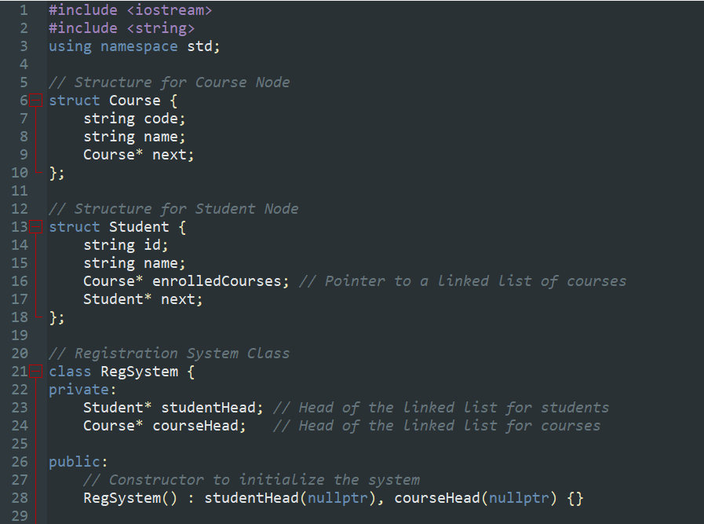
Data Structures
Using link lists as the data structure and class

Slide 12
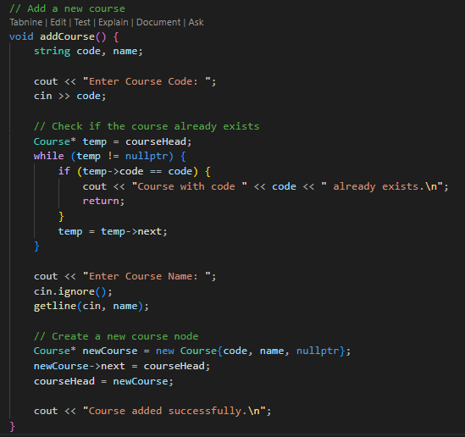
addCourse():
Adds a new course to the system after ensuring that the course code doesn't already exist.

Slide 13
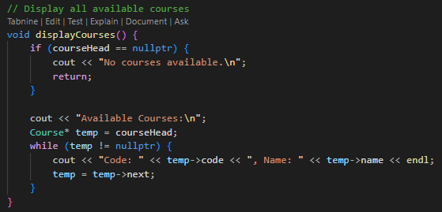
displayCourses():
Displays all available courses in the system.

Slide 14
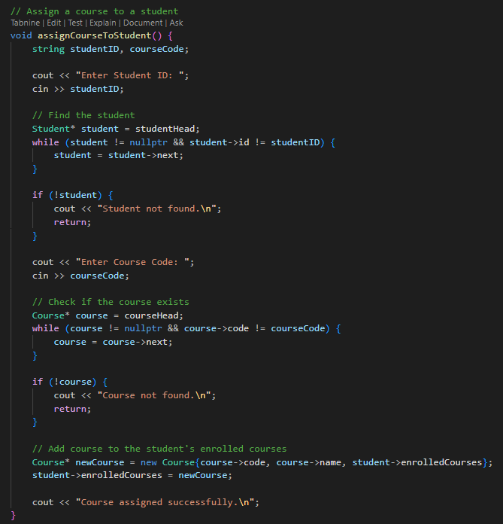
assignCourseToStudent():
Enrolls a student in a specified course. The student and course must already exist in the system.

Slide 15
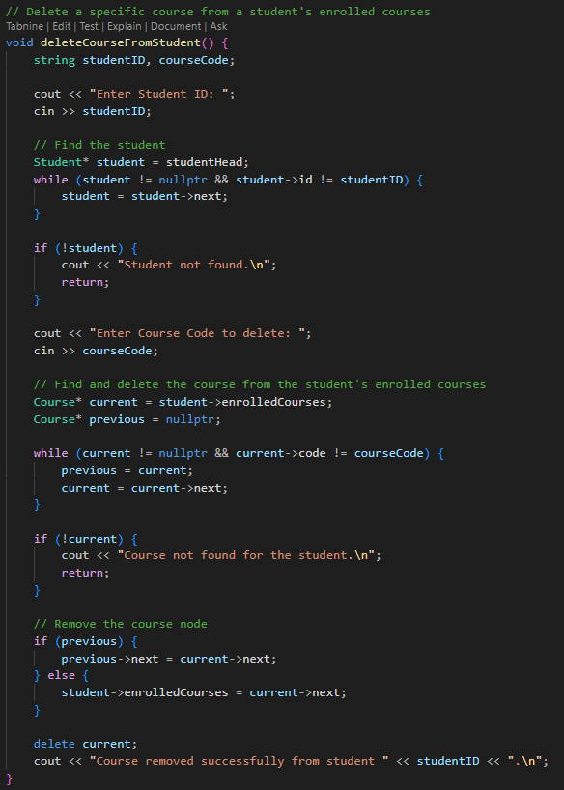
deleteCourseFromStudent():
Allows the removal of a course from a student's list of enrolled courses.

Slide 16
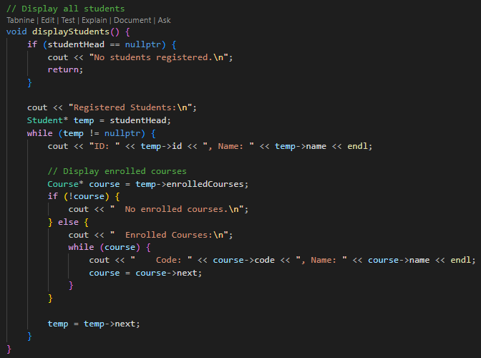
displayStudents():
Displays all registered students along with their enrolled courses.

Slide 17
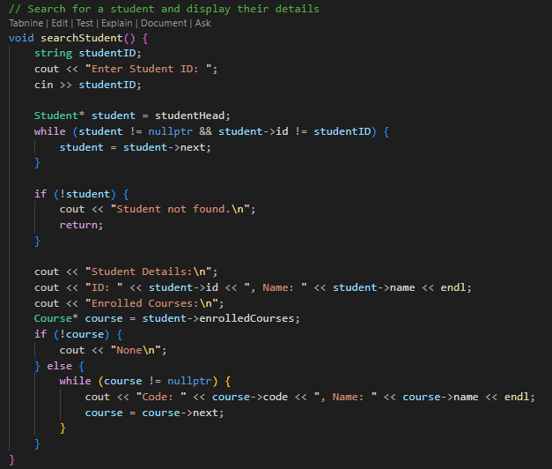
searchStudent():
Finds and displays a student's details, including their enrolled courses.

Slide 18
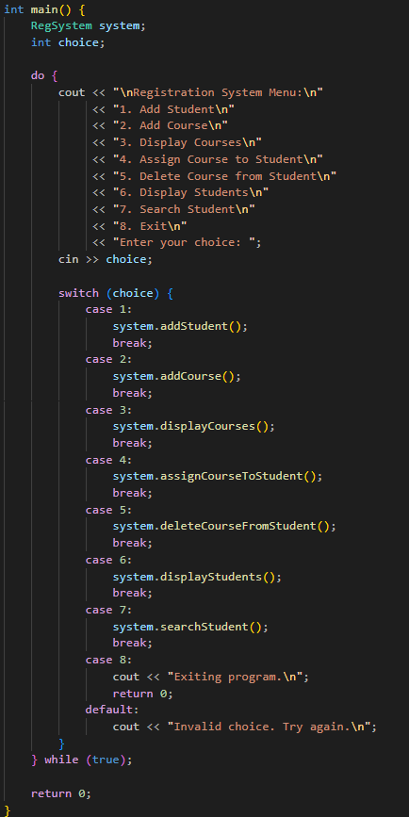
main():
Menu Loop: The program will continuously display the main menu using a do-while loop until the user selects option 8 to exit.
Choice Handling: The user's input (choice) is handled using a switch-case statement.

Slide 19
05
System Flow

Slide 20
Main Menu:
The program runs in a loop, displaying the menu options to the user until they choose to exit.
Options include adding students and courses, displaying students, and assigning/removing courses.
User Interaction:
The user interacts with the program by selecting options from the menu and entering data (e.g., student ID, course code).

Slide 21
06
Code Walkthrough

Slide 22
Student and Course Nodes:
The program utilizes two key structures, Student and Course, to store data.
Linked List Management:
The system maintains a linked list for both students and courses, allowing efficient insertion, deletion, and traversal.
Memory Management:
Dynamic memory allocation (new and delete) is used to create and delete nodes for students and courses, ensuring flexibility and efficiency.

Slide 23
07
Conclusion

Slide 24
This system demonstrates how linked lists can be used to implement a basic registration system with dynamic data management.
The ability to add, remove, and display both students and courses makes this a flexible and extensible system.
This design is scalable for larger systems by simply expanding the linked list as needed.

Slide 25
Thanks!

